Slide 1
An Introduction to Database
Introduction to Database for Undergraduate Study
Lecture 6
DML
Bulk Insertion
WHERE Clause
This lecture and its associated materials have been produced by Mr. Rohit Panday (M.Sc. IT, 10+ Years of Industry/Academic Experience) of iAcademy for the purposes of lecturing on the above described subject and the material should be viewed in this context. The work does not constitute professional advice and no warranties are made regarding the information presented. The Author and iAcademy do not accept any liability for the consequences of any action taken as a result of the work or any recommendations made or inferred. Permission to use any of these materials must be first granted by iAcademy.

Slide 2
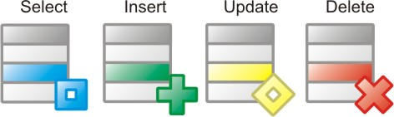
DML
DML statements affect records in a table. These are basic operations we perform on data such as selecting a few records from a table, inserting new records, deleting unnecessary records, and updating/modifying existing records.

Slide 3
TYPES OF DML
INSERT
Used to ADD record into table
DELETE
Used to REMOVE record from table
UPDATE
Used to MODIFY existing record
SELECT
Used to PROJECT columns from table

Slide 4

DML - INSERT
Syntax | INSERT into table-name values(data1,data2,..)
Examples | INSERT into Student values(101,'Adam',15);
Result
SIMPLE INSERT COMMAND

Slide 5
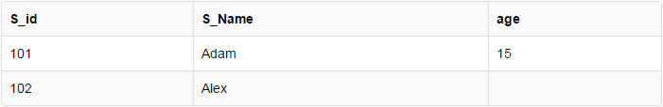
DML - INSERT
Example | INSERT into Student(id,name) values(102,'Alex');
Examples | INSERT into Student values(102,'Alex',null);
Result
Example to Insert NULL value to a column

Slide 6
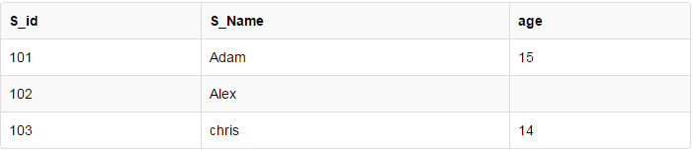
DML - INSERT
Example | INSERT into Student values(103,'Chris',default);
Result
Example to Insert DEFAULT value to a column

Slide 7
DML – INSERT - BULK
Syntax | INSERT INTO first_table_name [(column1, column2, ... columnN)] SELECT column1, column2, ...columnN FROM second_table_name [WHERE condition];
Example | INSERT into STUDENT values (SELECT * FROM student1);
Example for BULK Insertion

Slide 8
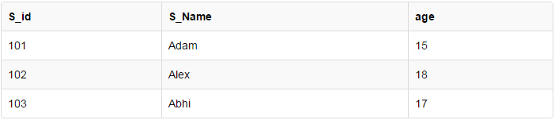
DML - UPDATE
Syntax | UPDATE table-name set column-name = value where condition;
Examples | UPDATE Student set s_name='Abhi',age=17 where s_id=103;
Result
SIMPLE UPDATE COMMAND

Slide 9
DML - DELETE
Syntax | DELETE from table-name;
Examples | DELETE from Student;
Result
SIMPLE UPDATE COMMAND

Slide 10
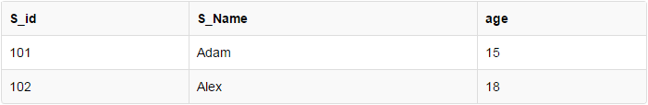
DML - DELETE
Syntax | DELETE from table-name WHERE condition;
Examples | DELETE from Student where s_id=103;
Result
SIMPLE UPDATE COMMAND

Slide 11
SQL - Category
DDL
CREATE, DROP, ALTER
DML
SELECT, INSERT, UPDATE, DELETE
TCL
COMMIT, ROLLBACK
DCL
GRANT, REVOKE

Slide 12

SQL – WHERE Clause
The WHERE clause is used to extract only those records that fulfill a specified criterion.
Generic Syntax of SELECT with WHERE Clause

Slide 13
Key Points
The SQL WHERE clause is used to specify a condition while fetching the data from single table or joining with multiple tables.
If the given condition is satisfied then only it returns specific value from the table. You would use WHERE clause to filter the records and fetching only necessary records.
The WHERE clause is not only used in SELECT statement, but it is also used in UPDATE, DELETE statement, etc.

Slide 14


SQL – WHERE Clause – Text & Numeric Fields
Single quotes around text values (some even support double quotes)
Numeric Fields should not be enclosed in quotes

Slide 15
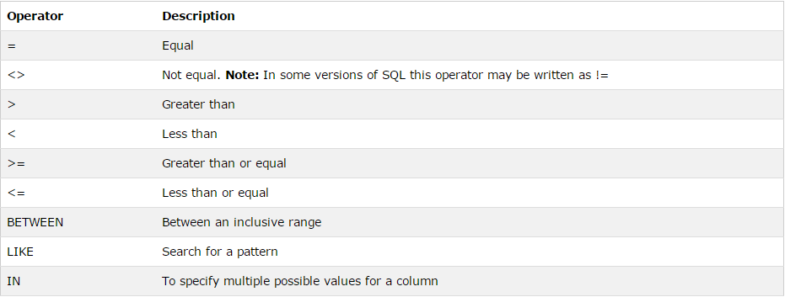
SQL – WHERE Clause – Operators

Slide 16
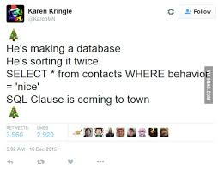
SQL – WHERE Clause – Operators

Slide 17
Key Points

Slide 18
Laugh

Slide 19

End of Lecture for Week - 6

